Slide 1
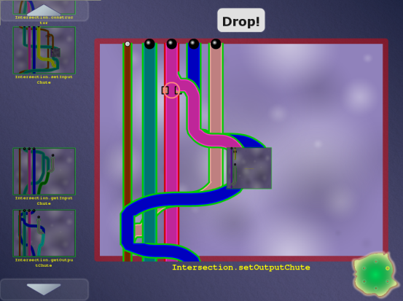
Verification games: Crowd-sourced software verification
As seen on Wired’s “Danger Room” blog yesterday
Michael Ernst University of Washington
Joint work with Seth Cooper, Werner Dietl, Stephanie Dietzel, Nat Mote, Tim Pavlik, Zoran Popović, Jeanette Wing

Slide 2
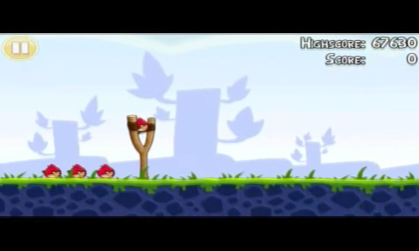
Angry Birds

Slide 3
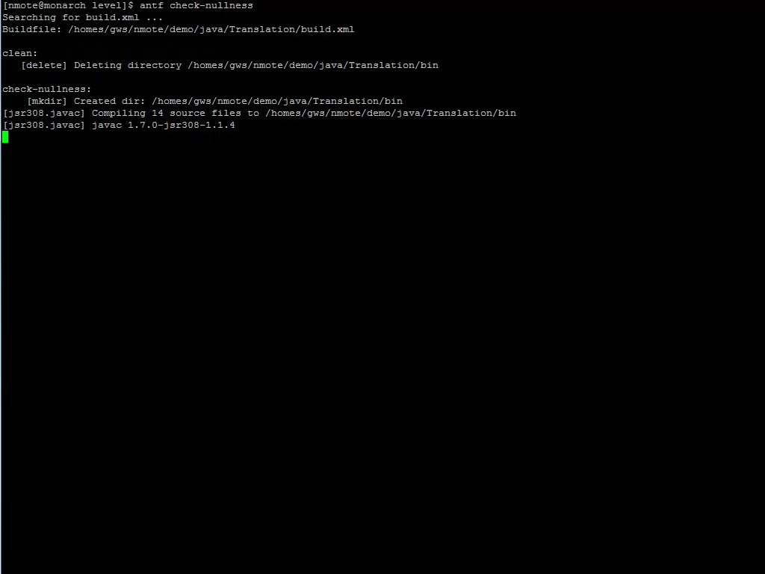
Software verification

Slide 4
Which is more fun?
Play games
Prove your program correct

Slide 5


Crowd-sourced software verification
Goal: Verify software while you wait for the bus
Make software verification easy and fun
Make the game accessible to everyone
Harness the power of the crowd

Slide 6
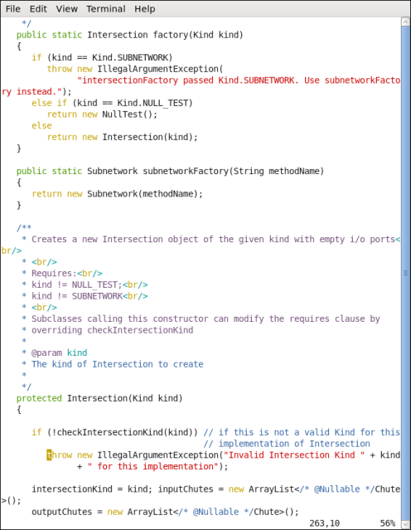

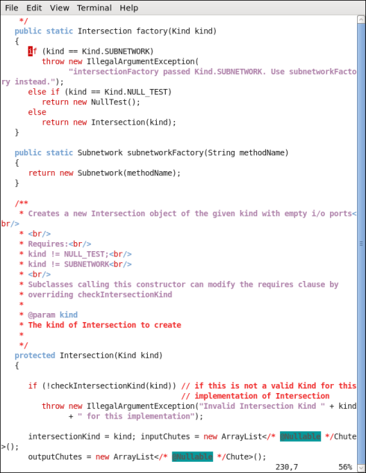


Code
Game
Automatic translation
Encodes a constraint system
Encodes a constraint system
Free labor
Highly-skilled, expensive labor
Verified software
(with proof/ annotations)
Completed game
Automatic translation

Slide 7
Pipe Jam game demo
Notes:
In the order: wind, earth, crash.

Slide 8
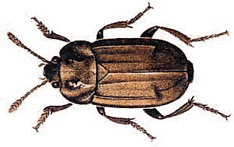

Code
Game
Automatic translation
Free labor
Highly-skilled, expensive labor
Bug detected, notify programmer
Completed game
with buzzsaws
Automatic translation

Slide 9



Program ↔ game correspondence
Idea: dataflow
Pipe ↔ a variable
Pipe width ↔ a property of the variable (type)
Ball ↔ a value
Ball size ↔ a property of the value
Pinch point ↔ requirement
Unmodifiable pipe/ball ↔ requirement

Slide 10
Example: encryption
Goal: no cleartext is sent over the network
Pipe ↔ a variable
Pipe width ↔ narrow: encrypted, wide: cleartext
Ball ↔ a value
Ball size ↔ small: encrypted, large: cleartext
Pinch point ↔ network communication
Unmodifiable pipe/ball ↔ cleartext from user

Slide 11
Example: null pointer errors
Goal: no dereference of null
Pipe ↔ a variable
Pipe width ↔ narrow: non-null, wide: maybe null
Ball ↔ a value
Ball size ↔ small: non-null, large: null
Pinch point ↔ dereference
Unmodifiable pipe/ball ↔ literal null

Slide 12
Other examples
SQL injection
unintended side effects
format string and regexp validation
incorrect equality checks
race conditions and deadlocks
units of measurement
aliasing
…

Slide 13
Challenges
Can we build the system?
End-to-end: game ↔ program verification
Will the game be fun?
Better than waiting for the bus
Do people outperform verification algorithms?
Inference is undecidable (human experts ≫ algorithms)
Hypothesis: no for correct, verifiable programs,
yes for incorrect or unverifiable programs
Game players only have to reduce overall verification cost, not fully verify the program
Also see FoldIt (protein folding)
Yes!
Maybe

Slide 14
Contributions
Gamification of program verification
Game corresponds to correctness condition
Game utilizes physical intuition
Game is playable by anyone
Game allows application of human insight
Goal: cheaper verification ⇒ more verification

